Slide 1


DATATECH LABS.
Data Engineering Course.
Week 1: Introduction to Data Engineering & Data Modeling

Slide 2
Outline: Week 1
Overview of Data Engineering
Role of a Data Engineer
Data Lifecycle
Data Modeling Concepts
Relational vs. NoSQL databases
Data modeling techniques for big data
Introduction to distributed database systems
DATATECH LABS.

Slide 3
Introduction to Data Engineering & Data Modeling
DATATECH LABS.

Slide 4
Defining Data Engineering
DATATECH LABS.

Slide 5
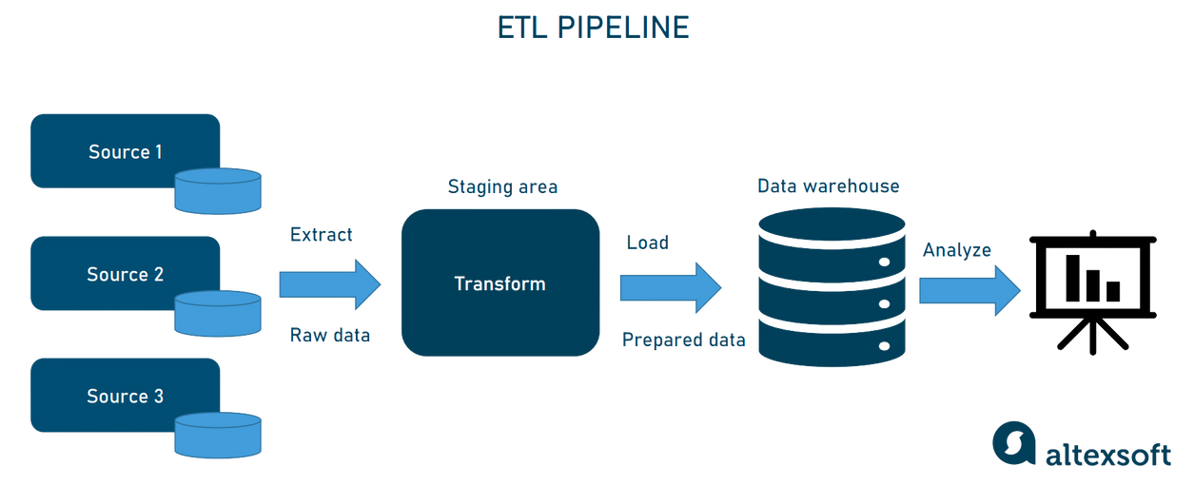
What is Data Engineering?
Definition: Data Engineering is the process of designing and building systems that allow for the collection, storage, and analysis of large datasets.
Discussion Point: Why is data engineering important in today’s data-driven world?
DATATECH LABS.

Slide 6
Data Engineering Terminologies
Data: Is the new oil. Data is any collection of information that can be used to make decisions or improve understanding of a situation. It can be in any form, including numbers, text, images, audio, or video.
Data Engineering: Is the discipline of designing, developing, and maintaining the architecture, tools, and systems that are used to collect, store, process, and analyze data.
Big Data: Is the term used to describe the large and complex datasets that are too big to be processed using traditional data processing methods.
DATATECH LABS.

Slide 7
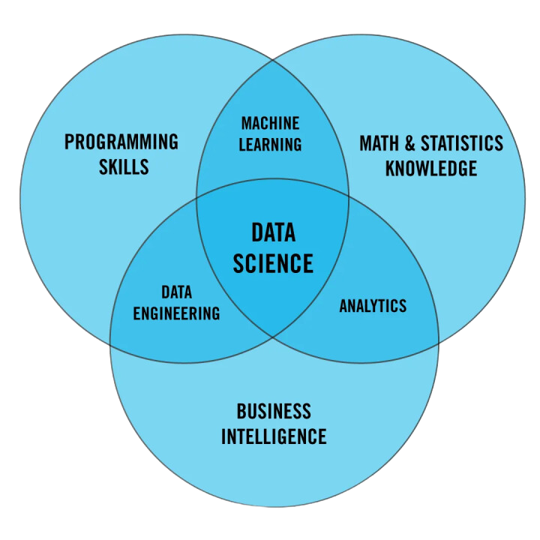
Roles in the Data World
Data Engineer
Data Scientist
Data Analyst
Machine Learning Engineer
Database Administrator
DATATECH LABS.

Slide 8
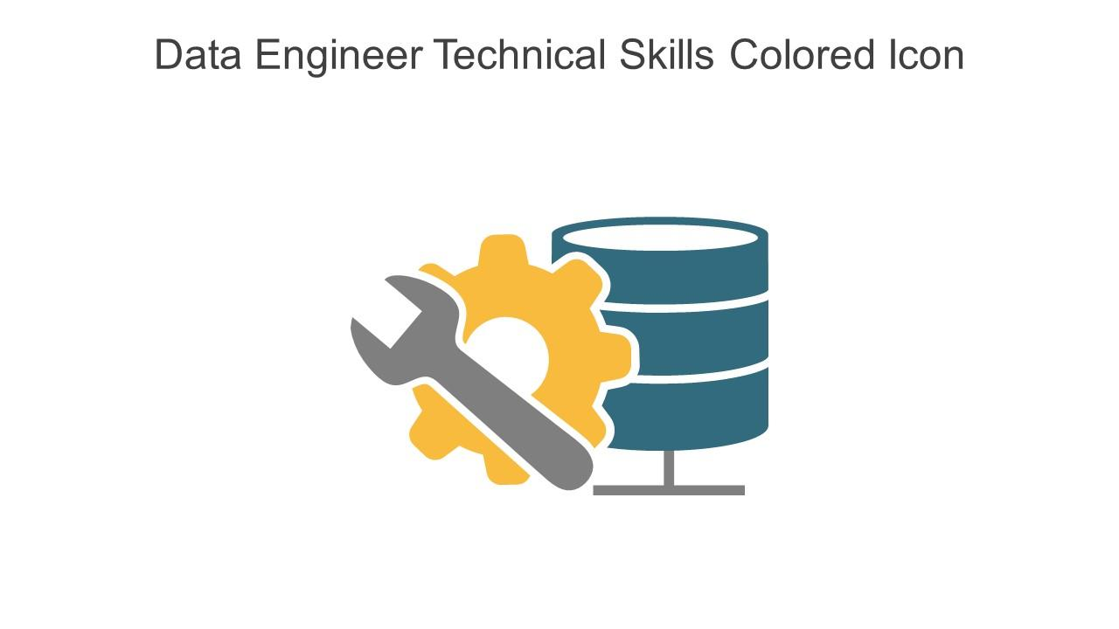
The Role of a Data Engineer
Responsibilities:
Designing data pipelines
Building data infrastructure
Data collection and integration
Ensuring data quality and consistency
Discussion Point: How does the role of a data engineer differ from a data scientist?
DATATECH LABS.

Slide 9
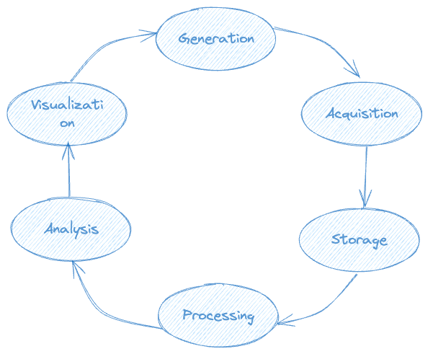
The Data Lifecycle
Data Generation
Data Acquisition
Data Storage
Data Processing
Data Analysis
Data Visualization
DATATECH LABS.

Slide 10
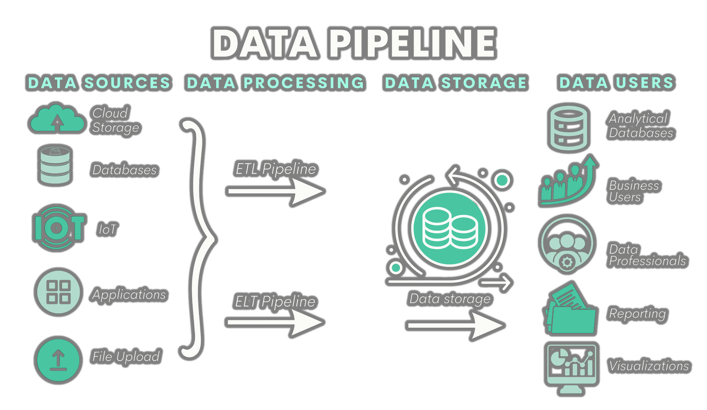
Key Concepts in Data Engineering
Data Pipeline: A set of processes that move data from one system to another.
ETL (Extract, Transform, Load): The process of extracting data from sources, transforming it into a usable format, and loading it into storage.
Data Lake: A storage repository that holds vast amounts of raw data in its native format.
Data Warehouse: A system used for reporting and data
analysis, storing integrated data from multiple sources.
DATATECH LABS.

Slide 11

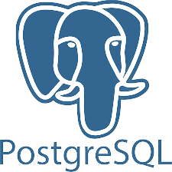







Tools and Technologies
Apache Hadoop
Apache Spark
Apache Kafka
Apache Flink
Apache Airflow
SQL Databases (e.g., MySQL, PostgreSQL)
NoSQL Databases (e.g., MongoDB, Cassandra)
Business Intelligence (BI) Tools
DATATECH LABS.

Slide 12




Course Tools and Setup
Python
Jupyter Notebook
Docker
GitHub
Instructions for installing and setting up the tools
DATATECH LABS.

Slide 13
Hands-on: Setting Up Your Environment
Download Python: python.org
Download Docker Desktop: docker.com
Create your python virtual environment with command:
`python3 -m venv <env_name>`
Create your GitHub account: github.com
Create a new repository for the course.
Push your Jupyter Notebook to the repository.
DATATECH LABS.

Slide 14

Hands-on:
Introduction to Python for Data Engineering.
Setting up your environment.
DATATECH LABS.

Slide 15
Data Modeling and Architecture
DATATECH LABS.

Slide 16
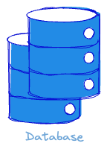
First: What is a Database?
A database is an organized collection of information, or data, typically stored electronically in a computer system.
Key Components:
Data: Raw facts or figures, which might include numbers, text, or multimedia.
Database Management System (DBMS): Software that interacts with users, applications, and the database itself to capture and analyze data.
Purpose:
Databases are used to store, retrieve, and manage data efficiently.
They support operations such as data querying, updating, and administration.
DATATECH LABS.

Slide 17
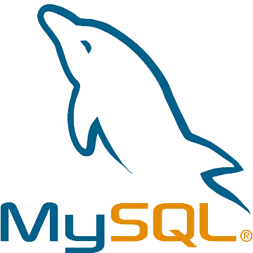
Relational Databases
Based on the relational model of data
Organizes data into tables (relations) with rows and columns
Key concepts:
Tables, Columns, Rows
Primary Keys, Foreign Keys
Normalization
Examples: MySQL, PostgreSQL, Oracle
DATATECH LABS.

Slide 18


NoSQL Databases
"Not Only SQL" or non-relational databases
Designed to handle various forms of data and large volumes of data
Types of NoSQL databases:
Document stores (e.g., MongoDB)
Key-value stores (e.g., Redis)
Column-family stores (e.g., Cassandra)
Graph databases (e.g., Neo4j)
DATATECH LABS.

Slide 19
Choosing Between Relational and NoSQL
Aspect | Relational | NoSQL
Data Structure | Structured | Structured/Semi-structured
Schema | Fixed | Flexible
Scalability | Vertical | Horizontal
ACID Compliance | Yes | Often sacrificed for performance
Use Cases | Complex queries, transactions | High volume, high velocity data
DATATECH LABS.

Slide 20
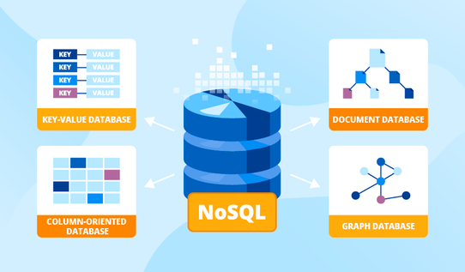
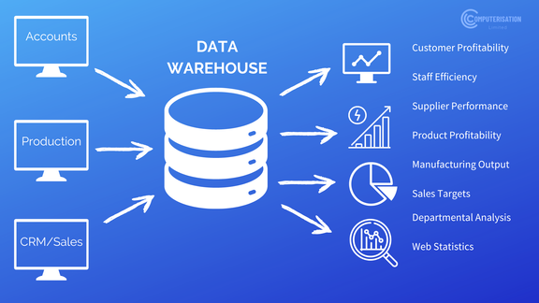

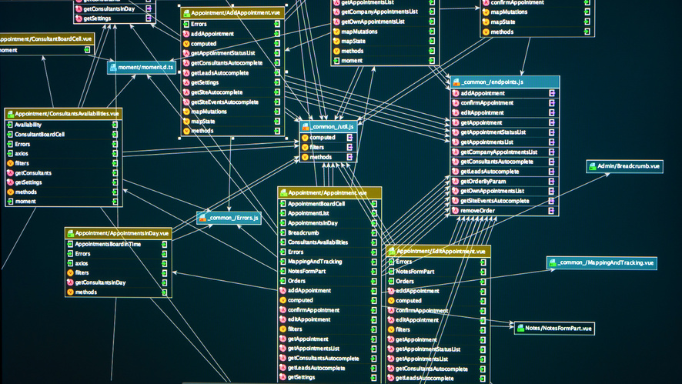
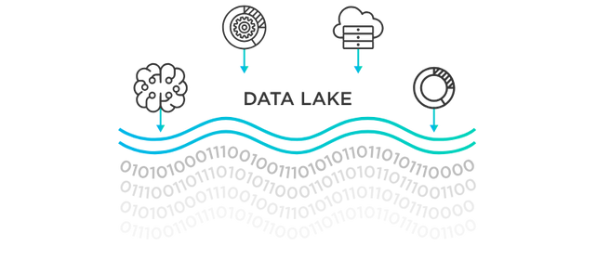
Data Storage Systems
The type of data storage that is used depends on the volume, velocity, and variety of the data. Common data storage options include:
Relational Databases. Structured data
NoSQL Databases. Unstructured data
Data Warehouses.
Structured Big data
Data Lakes.
Big data
DATATECH LABS.

Slide 21
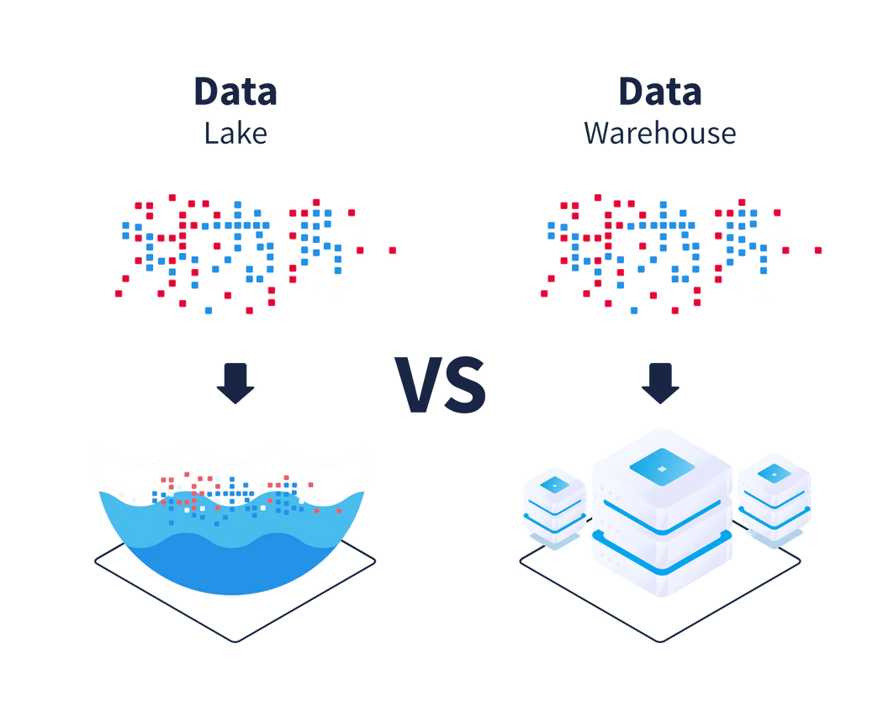
Defining Data Warehouses and Data Lakes
Both are storage tools, but:
Data Warehouse: A centralized repository that stores structured integrated data from multiple sources, optimized for querying and analysis. Stores structured data, schema-on-write, optimized for read operations.
Data Lake: Raw data, schema-on-read, optimized for
storage and batch processing.
Discussion Point: When would you choose a data lake
over a data warehouse?
DATATECH LABS.

Slide 22
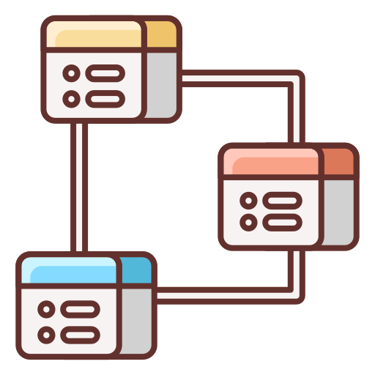
Data Modeling Concepts
Definition: Data Modeling is the process of creating a data model to visually represent the structure of data.
Discussion Point: Why is data modeling important in database design?
DATATECH LABS.
Notes:
note 15

Slide 23
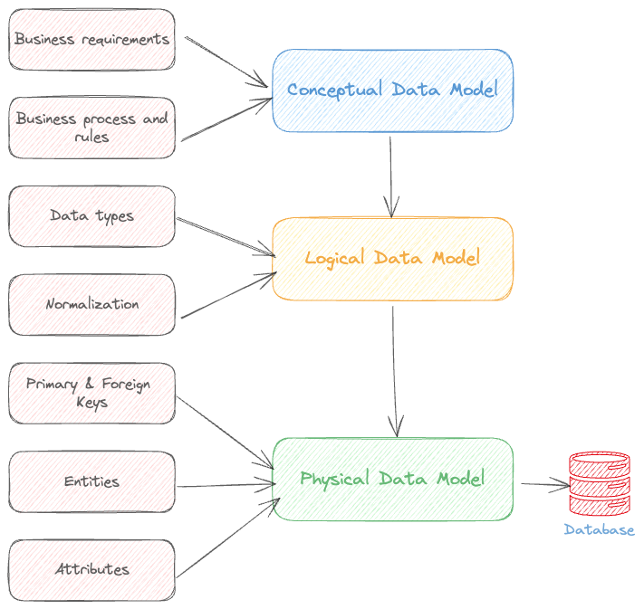
Types of Data Models
Conceptual Data Model: High-level overview of data entities and relationships.
Logical Data Model: Detailed description of data entities, attributes, and relationships.
Physical Data Model: Specification of data storage and access methods.
DATATECH LABS.
Notes:
note 16

Slide 24

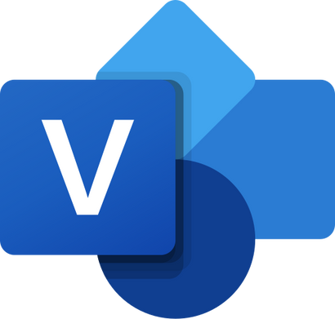

Tools for Data Modeling
DBeaver
Draw.io
ER/Studio
ERwin Data Modeler
Microsoft Visio
DATATECH LABS.

Slide 25
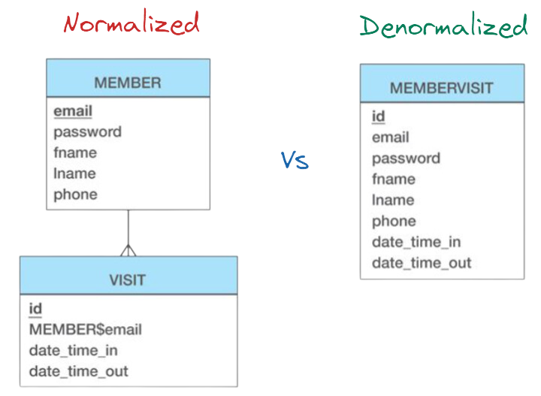
Data Modeling Techniques
Denormalization: Combining multiple tables to improve read performance
Wide-column design: For handling sparse data
Nested structures: For complex, hierarchical data
Polyglot persistence: Using multiple database types for different data needs
DATATECH LABS.

Slide 26
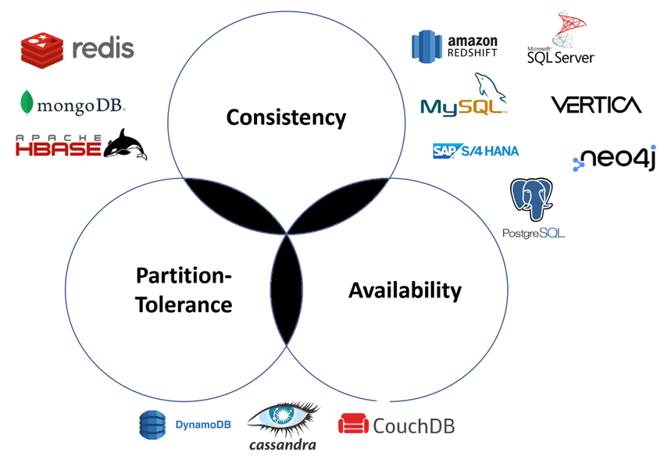
CAP Theorem
Definition: A distributed database is a database in which storage devices are distributed across multiple nodes or servers, where they all work together
CAP Theorem states that it is impossible for a distributed data store to simultaneously provide more than two out of the following three guarantees:
Consistency: Every read receives the most recent write or an error
Availability: Every request receives a response, without guarantee that it contains the most recent version of the information
Partition tolerance: The system continues to operate despite network partitions
DATATECH LABS.

Slide 27
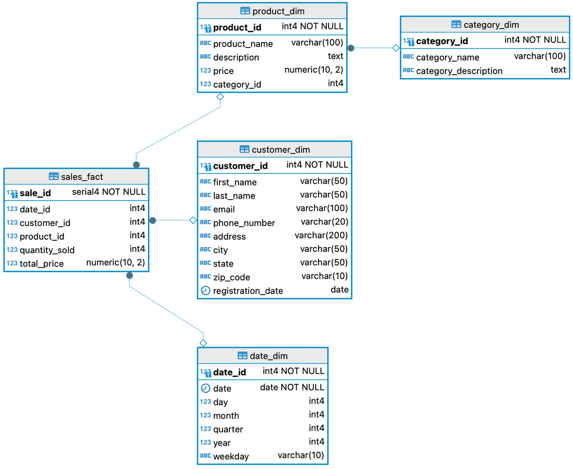
Case Study: Designing a Data Model
E-commerce business data model
Identify entities, attributes, and relationships
DATATECH LABS.

Slide 28

SQL: Structured Query Language
Definition: a standard language for accessing and manipulating databases.
Query: Is a question or inquiry about a set of data. We use SQL to retrieve meaningful and relevant information from databases.
SQL stands for Structured Query Language.
SQL lets you access and manipulate databases
DATATECH LABS.

Slide 29
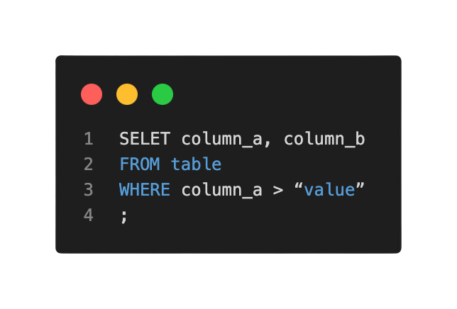
What is SQL Used for?
CRUD Operations: CREATE, READ, UPDATE, and DELETE records from databases.
SQL can create new databases.
SQL can create new tables in a database.
and more...
DATATECH LABS.

Slide 30
Hands-on:
Designing a Data Model and Querying it
DATATECH LABS.

Slide 31
Q&A and Discussion
DATATECH LABS.

Slide 32

MEET OUR TEAM
Omar AlSaghier
Sr. Data Engineer
DATATECH LABS.

Slide 33







DATATECH LABS.
THANK YOU
OUR CONTACT
DataTechLabs
datatechlabs.ai@gmail.com
datatechlabs.ai
Amman, Jordan

